Slide 1


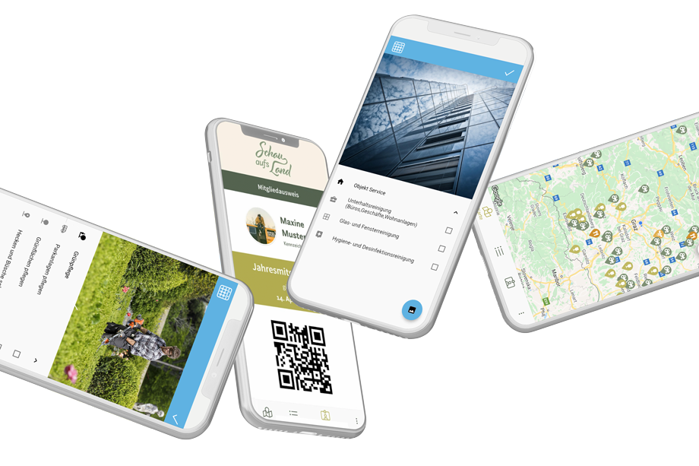
Python meets Flutter

Slide 2


Agenda
Vorstellungsrunde
Impuls Entwicklung Flutter & Python
Architekturüberblick
Beispiel-Anwendung
Diskussion und Erfahrungsauschtausch

Slide 3
Vorstellungsrunde

Slide 4
Impuls Entwicklung Flutter & Python

Slide 5
Python Backend

Slide 6
Architektur-überblick
Datenhaltung
Backend
Interface
Frontend
Django

Slide 7
Architektur-überblick
Datenhaltung
Backend
Interface
Frontend
SQLite - local file - fast - only 1 write
Django
PostgreSQL - requires server - scalable - GIS, JSON, XML - full text search
Other SQL - MySQL - Oracle

Slide 8
Architektur-überblick
Datenhaltung
Backend
Interface
Frontend
SQLite - local file - fast - only 1 write
Django
PostgreSQL - requires server - scalable - GIS, JSON, XML - full text search
Django templates & forms
Other SQL - MySQL - Oracle

Slide 9
Architektur-überblick
Datenhaltung
Backend
Interface
Frontend
SQLite - local file - fast - only 1 write
Django
PostgreSQL - requires server - scalable - GIS, JSON, XML - full text search
Django templates & forms
Other SQL - MySQL - Oracle
HTMX JavaScript ...

Slide 10
Flutter Frontend

Slide 11
Architektur-überblick
Datenhaltung
Backend
Interface
Frontend
SQLite - local file - fast - only 1 write
Django
Flutter
PostgreSQL - requires server - scalable - GIS, JSON, XML - full text search
Django templates & forms
Other SQL - MySQL - Oracle
HTMX JavaScript ...

Slide 12
Architektur-überblick
Datenhaltung
Backend
Interface
Frontend
Firebase
- service
SQLite - local file - fast - only 1 write
Django
Flutter
PostgreSQL - requires server - scalable - GIS, JSON, XML - full text search
Django templates & forms
Other SQL - MySQL - Oracle
HTMX JavaScript ...

Slide 13
Architektur- überblick
Datenhaltung
Backend
Interface
Frontend
Firebase
- service
SQLite - local file - fast - only 1 write
Django REST Framework
Django
Flutter
PostgreSQL - requires server - scalable - GIS, JSON, XML - full text search
Django templates & forms
Other SQL - MySQL - Oracle
HTMX JavaScript ...

Slide 14
Architektur-überblick
Datenhaltung
Backend
Interface
Frontend
Firebase
- service
SQLite - local file - fast - only 1 write
Django REST Framework
Django
Flutter
PostgreSQL - requires server - scalable - GIS, JSON, XML - full text search
Django templates & forms
Other SQL - MySQL - Oracle
HTMX JavaScript ...

Slide 15
Python Backend

Slide 16
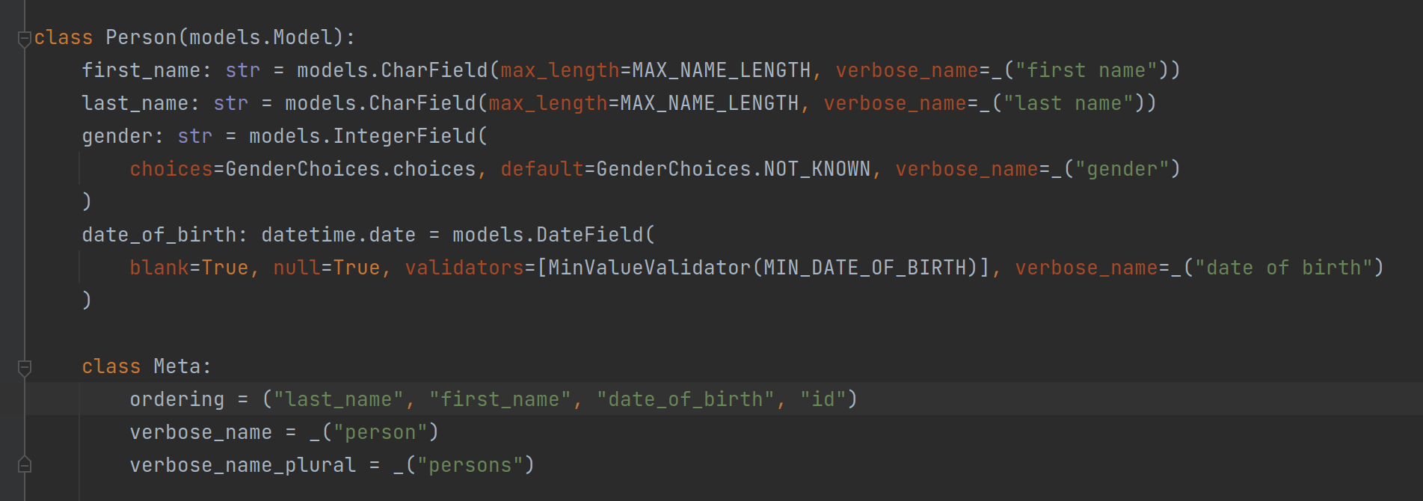
Django Model

Slide 17
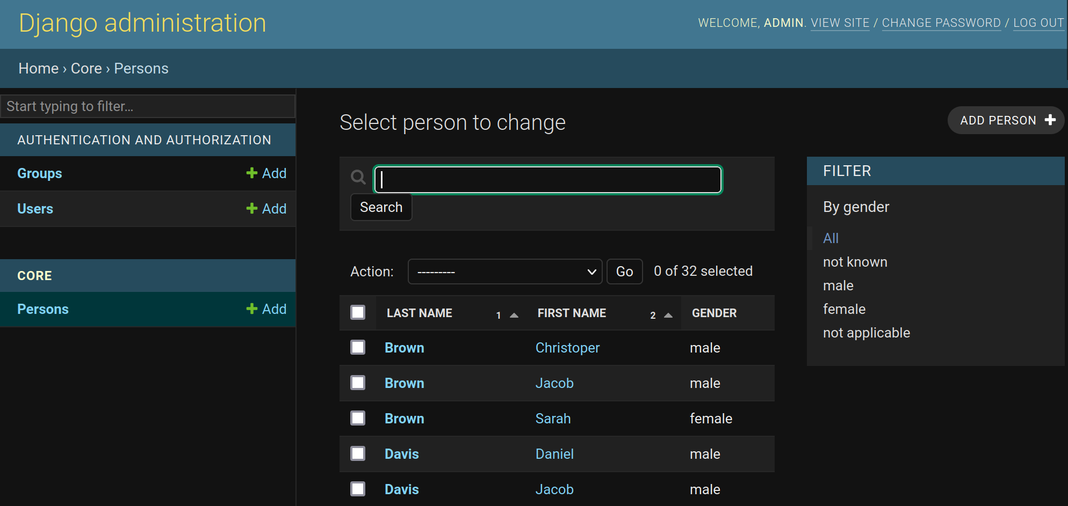
Django Admin

Slide 18
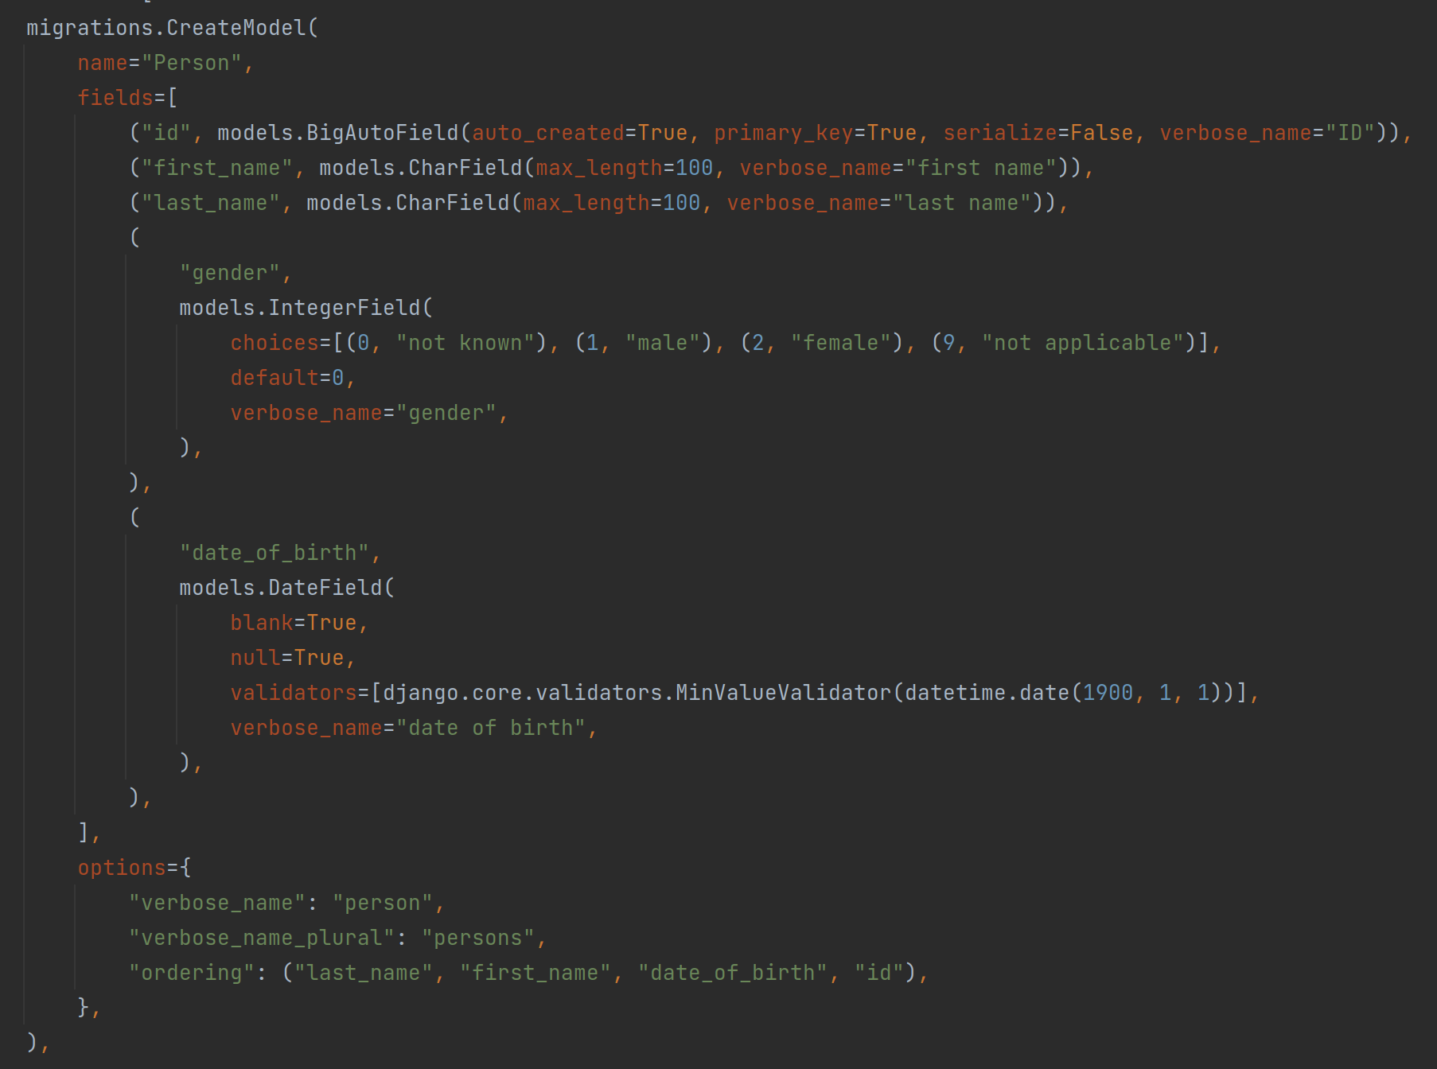
Datenbank Migration

Slide 19
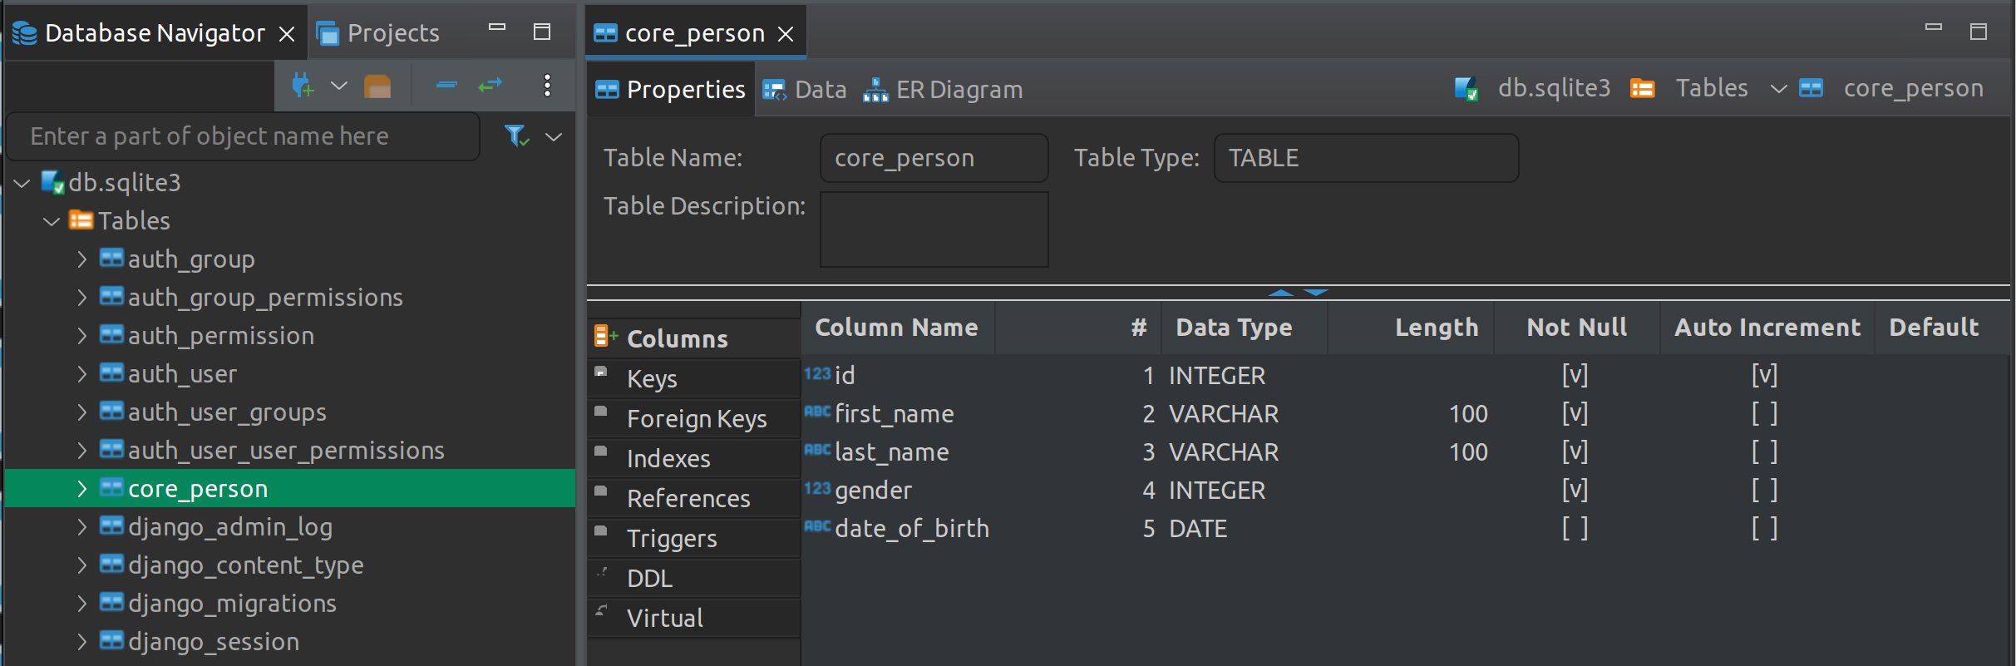
Datenbank- Tabelle

Slide 20
Flutter Frontend

Slide 21
Foto

Slide 22

Euer Feedback
Notes:
https://forms.gle/Ds8A5wDqpVfTS7xD7

Slide 23
Happy networking!

